Slide 2

PLEASE CLICK TO START THE GAME!

Slide 3







$ 200
$ 200
$ 200
$ 200
$ 200
$ 200
$ 400
$ 400
$ 400
$ 400
$ 400
$ 400
$ 600
$ 600
$ 600
$ 600
$ 600
$ 600
$ 800
$ 800
$ 800
$ 800
$ 800
$ 800
$ 1000
$ 1000
$ 1000
$ 1000
$ 1000
$ 1000

Slide 4


Slide 5
HISTORY
OF R

Slide 7
ggplot2

Slide 9
dplyr

Slide 11
HEX STICKERS

Slide 13
R PACKAGES

Slide 15
BASE R

Slide 16

































HISTORY OF R
ggplot2
HEX STICKERS
PACKAGES
dplyr
BASE R
YOU FINISHED THIS GAME
TIME TO COUNT THE MONEY!

Slide 17
ROSS IHAKA AND ROBERT GENTLEMAN MADE THIS FAMOUS ACCOMPLISHMENT.
Click here for the answer

Slide 18
Solution:
WHAT IS CREATED R?
$ 200

Slide 19
S, LISP, and SCHEME ARE THESE PROGRAMMING LANGUAGES?
Click here for the answer

Slide 20
Solution:
WHAT ARE THE LANGUAGES THAT INFLUENCED R?
$ 400

Slide 21
THIS FAMOUS EVENT, MARKING THE BEGINNING OF A LONG SERIES OF RELEASES, OCCURRED IN 1993
Click here for the answer

Slide 22
Solution:
WHAT IS R WAS FIRST RELEASED? OR R WAS FIRST CIRCULATED ON THE STATNEWS AND S-NEWS FORUMS
$ 600

Slide 23
THIS EVENT, SPECIALLY NOTED WITH A “V“, OCCURED ON FEBRUARY 29 2000
Click here for the answer

Slide 24
Solution:
WHAT IS WHEN R VERSION 1.0 WAS RELEASED?
$ 800

Slide 25
THIS WAS THE YEAR THAT R INTRODUCED THE NEW PIPE |> OPERATOR IN 4.1.0?
Click here for the answer

Slide 26
Solution:
WHEN WAS 2021?
$ 1000

Slide 27
This is what the + symbol does in the context of ggplot2?
Click here for the answer

Slide 28
Solution:
What is combines ggplot2 layers?
$ 200

Slide 29
This is the purpose of ggplot2?
Click here for the answer

Slide 30
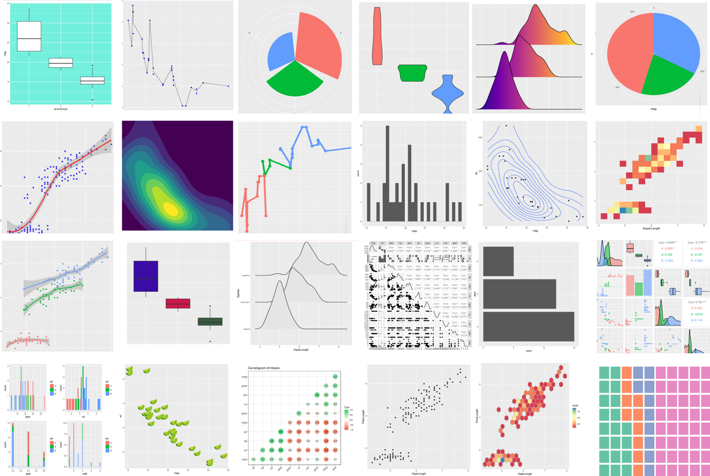
Solution:
What is to create data visualizations?
$ 400

Slide 31
This is what the “gg” stand for.
Click here for the answer

Slide 32
Solution:
What is the “Grammar of Graphics”?
$ 600

Slide 33
This is the geom used to create a scatterplot?
Click here for the answer

Slide 34
Solution:
What is geom_point
$ 800

Slide 35
In ggplot2, this is the function used to define the mapping between columns of data and different visual channels used for communication.
Click here for the answer

Slide 36
Solution:
What is the aes() command?
(which stands for aesthetics)
$ 1000

Slide 37
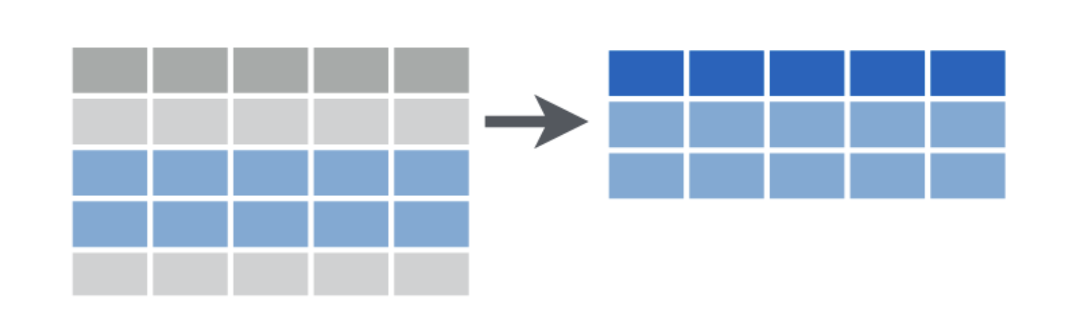
This function from dplyr is used to extract rows from a dataframe based on conditions set by the user.
Click here for the answer

Slide 38
Solution:
What is filter?
$ 200

Slide 39
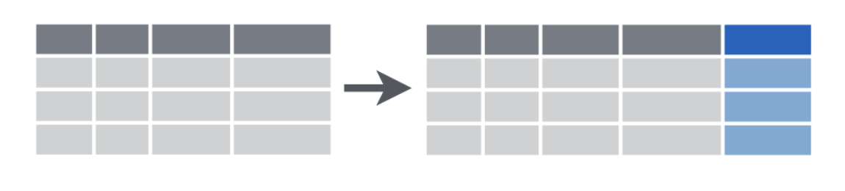
This function is used to create new variables, by altering and/or combining values from existing columns.
Click here for the answer

Slide 40
Solution:
What is mutate?
$ 400

Slide 41
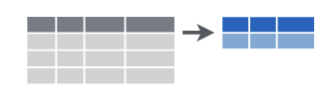
This function is used to collapse values from a dataframe or grouped data frame into summary measures.
Click here for the answer

Slide 42
Solution:
What is summarize?
$ 600

Slide 43
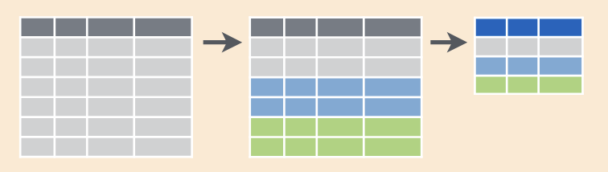
This common sequence computes a summary row for each group in a dataframe.
Click here for the answer

Slide 44
Solution:
What are group_by and summarize?
$ 800

Slide 45
This function is used to sum the number of unique observations that contain some particular value or categorical attribute.
Click here for the answer

Slide 46
Solution:
What is count?
$ 1000

Slide 47

This package, popularly used for dataframe manipulation in an intuitive, user-friendly
way, is associated with this sticker.
Click here for the answer

Slide 48

$ 200

Slide 49

This package, used to create tidy data, where tidy data are such that every column is variable, every row is an observation, and every cell is a single value, is associated with this hex sticker.
Click here for the answer

Slide 50

$ 400

Slide 51

This package implements a modern reimagining of the data.frame which is lazy and surly: they do less (i.e. they don’t change variable names or types, and don’t do partial matching) and complain more (e.g. when a variable does not exist).
Click here for the answer

Slide 52

$ 600

Slide 53

This package provides a suite of tools that solve common problems with factors, including changing the order of levels or the values.
Click here for the answer

Slide 54

$ 800

Slide 55

This package provides a fast and friendly way to read rectangular data from delimited files, such as comma-separated values (CSV) and tab-separated values (TSV), designed to parse many types of data found in the wild.
Click here for the answer

Slide 56

$ 1000

Slide 57
This package allows users to write reproducible, dynamic reports with R
Click here for the answer

Slide 58
Solution:
What is rmarkdown?
$ 200

Slide 59
This package allows users to create interactive web apps in R?
Click here for the answer

Slide 60
Solution:
What is shiny?
$ 400

Slide 61
This package authored by Max Kuhn, Hadley Wickham, and Julia Silge implements a framework for modeling and machine learning using tidyverse principles
Click here for the answer

Slide 62
Solution:
What is tidymodels?
$ 600

Slide 63
This tidyverse package provides a cohesive set of functions designed to make working with strings as easy as possible.
Click here for the answer

Slide 64

Solution:
What is stringr?
$ 800

Slide 65

This is the command used to load a package in R.
Click here for the answer

Slide 66
Solution:
What is library?
$ 1000

Slide 67
These base R commands are used to perform functional programming tasks, like applying a function to a list of objects.
Click here for the answer

Slide 68
Solution:
What are the apply family functions, like vapply, sapply, mapply, lapply and apply?
$ 200

Slide 69
This is the function to retrieve the density of the normal distribution for a given value.
Click here for the answer

Slide 70
Solution:
What is dnorm?
$ 400

Slide 71
This function will return the structure of an object.
Click here for the answer

Slide 72
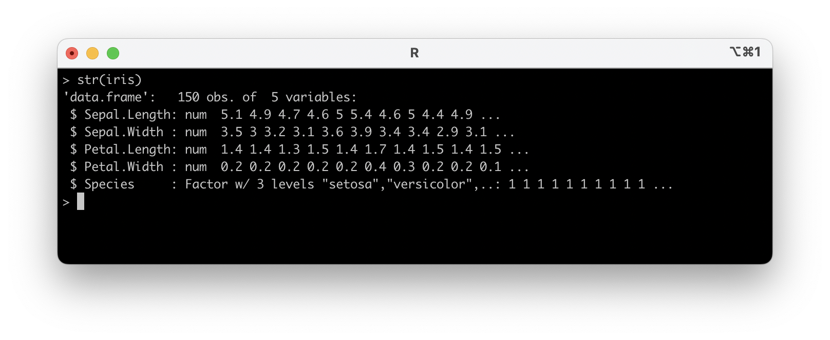
Solution:
What is str?
$ 600

Slide 73
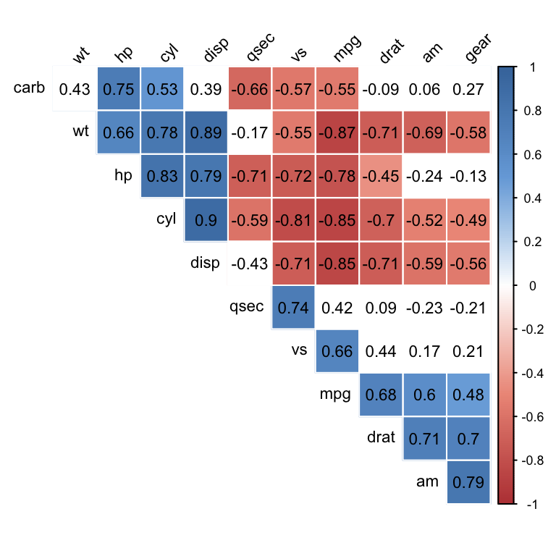
This function calculates the correlation between two vectors.
Click here for the answer

Slide 74
Solution:
What is cor?
$ 800

Slide 75
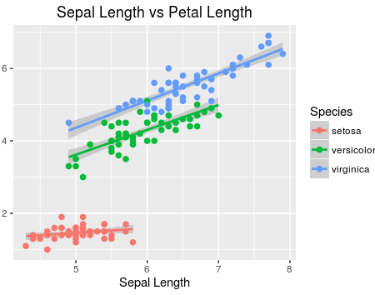
This function constructs a linear model in R given a formula and data.
Click here for the answer

Slide 76
Solution:
What is lm?
$ 1000

Slide 77


Free Download:
https://slidelizard.com

